Slide 1
Chapter VII
Rasterizer
All class materials including this PowerPoint file are available at
https://github.com/medialab-ku/openGLESbook

Slide 2
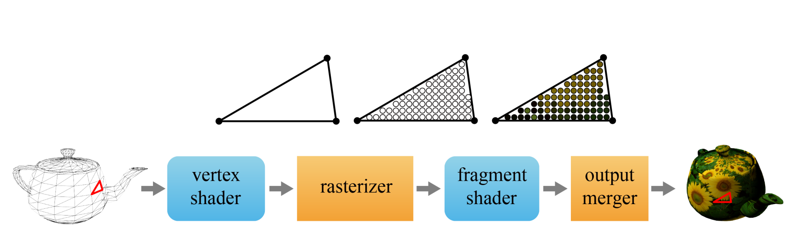
Rasterizer
The vertex shader passes the clip-space vertices to the rasterizer, which assembles the vertices into triangles and then breaks up each triangle into fragments.
The rasterizer performs the following:
  Clipping
  Perspective division
  Back-face culling
  Viewport transform
  Scan conversion
7-<number>

Slide 3
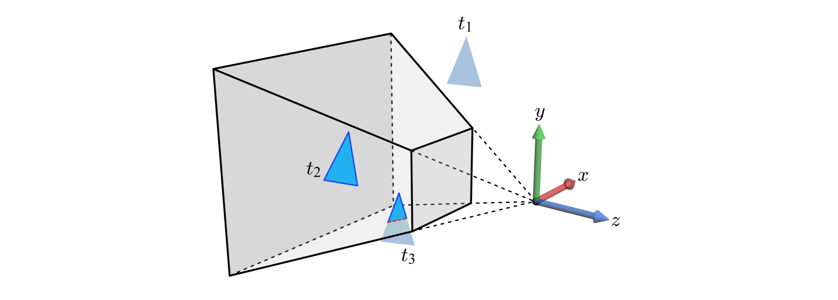
Clipping
Clipping is performed in the clip space, but the following figure presents its concept in the camera space, for the sake of intuitive understanding.
  Triangle t₁ is completely outside of the view frustum and is discarded.
  Triangle t₂ is completely inside and is passed as is to the next step.
  Triangle t₃ intersects the view frustum and is thus clipped.
As a result of clipping, vertices may be added to and deleted from the triangle.
7-<number>

Slide 4
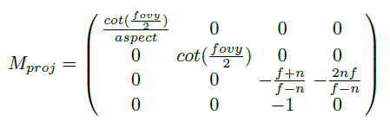
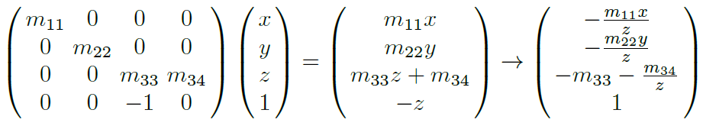
Perspective Division
Unlike affine transforms, the last row of M_{proj} is not (0 0 0 1) but (0 0 -1 0). When M_{proj} is applied to (x,y,z,1), the w-coordinate of the transformed vertex is –z.
In order to convert from the homogeneous (clip) space to the Cartesian space, each vertex should be divided by its w-coordinate, which equals –z.
7-<number>

Slide 5
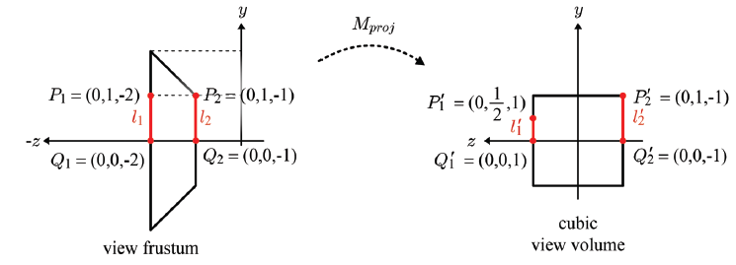
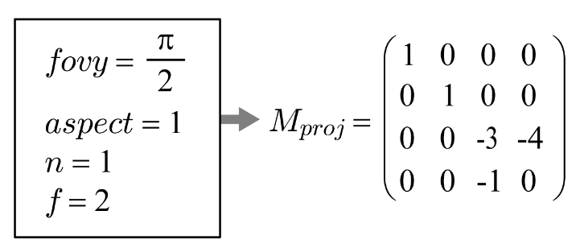
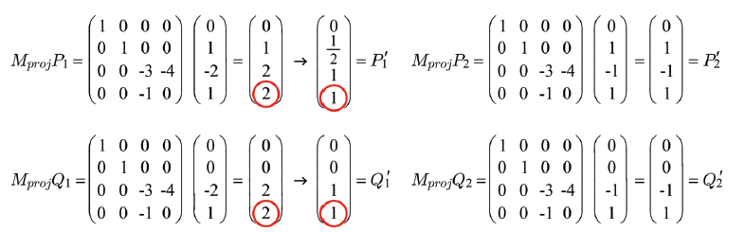
Perspective Division (cont’d)
Note that –z is a positive value representing the distance from the xy-plane of the camera space. Division by –z makes distant objects smaller. It is perspective division. The result is said to be in NDC (normalized device coordinates).
7-<number>

Slide 6
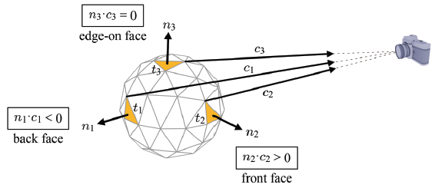
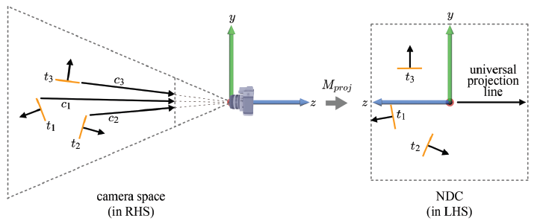
Back-face Culling
The polygons facing away from the viewpoint of the camera are called the back faces. They are culled. The polygons facing the camera are called the front faces. They are preserved.
The projection transform defines a universal projection line parallel to the z-axis.
7-<number>

Slide 7
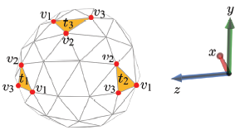
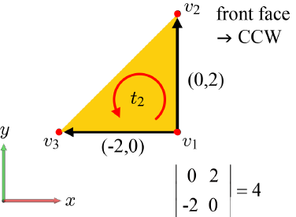
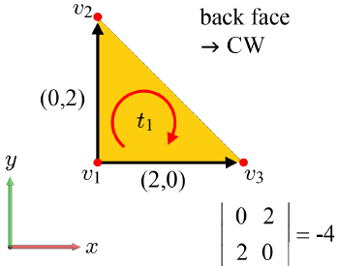

Back-face Culling (cont’d)
Let us take only the x- and y-coordinates of every vertex. It corresponds to projecting the triangles along the universal projection line onto the xy-plane. A 2D triangle with CCW vertex order is a front face, and a 2D triangle with CW vertex order is a back face.
Compute the following determinant, where the first row represents the 2D vector connecting v₁ and v₂, and the second row represents the 2D vector connecting v₁ and v₃.
  If it is positive, CCW and so front face.
  If negative, CW and so back face.
  If 0, edge-on face.
7-<number>

Slide 8
Back-face Culling (cont’d)
  The back faces are not always culled.
    Consider rendering a hollow translucent sphere. For the back faces to show through the front faces, no face should be culled.
    Consider culling only the front faces of the sphere. Then the cross-section view of the sphere will be obtained.
  Various GL capabilities are enabled by glEnable and disabled by glDisable.
An example is glEnable(GL_CULL_FACE), which enables face culling.
The default value is GL_FALSE.
7-<number>

Slide 9
Back-face Culling (cont’d)
When face culling is enabled, glCullFace() specifies whether front or back faces are culled. It accepts the following symbolic constants:
  GL_FRONT
  GL_BACK
  GL_FRONT_AND_BACK
The default value is GL_BACK, and back faces are culled.
Then, glFrontFace() specifies the vertex order of front faces. It accepts the following:
  GL_CW
  GL_CCW
The default value is GL_CCW.
7-<number>

Slide 10
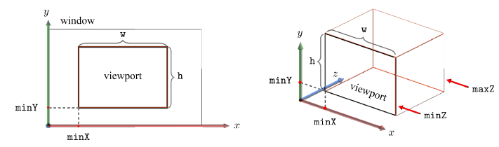
Viewport
A window at the computer screen is associated with its own window space or screen space.
A viewport defines a screen-space rectangle into which the scene is projected. It is not necessarily the entire window, but can be a sub-area of the window.
  void glViewport(GLint minX, GLint minY, GLsizei w, GLsizei h)
In reality, the screen space is 3D and so is the viewport.
  void glDepthRangef(GLclampf minZ, GLclampf maxZ)
  The default values of minZ and maxZ are 0.0 and 1.0, respectively.
Note that the screen space is left-handed.
7-<number>

Slide 11
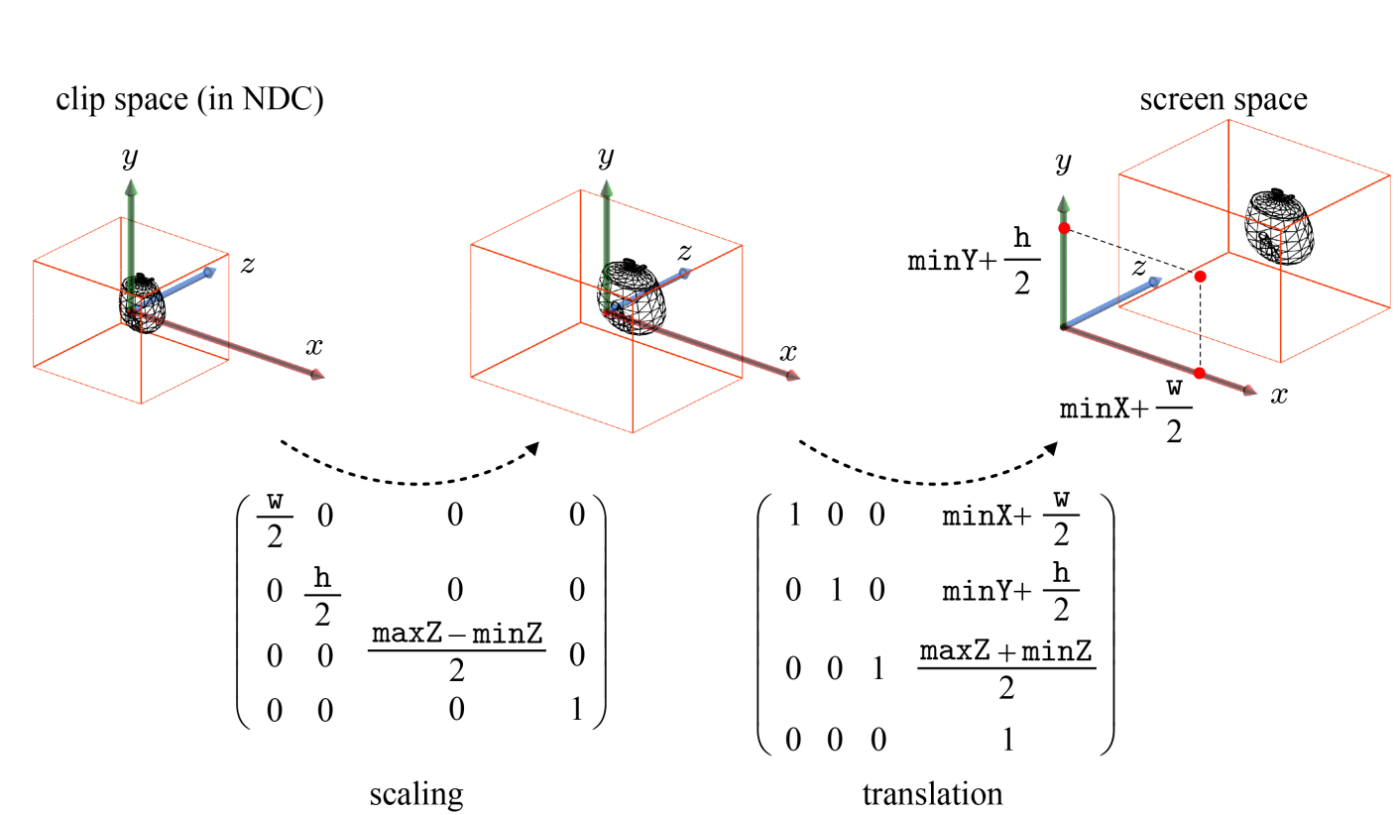
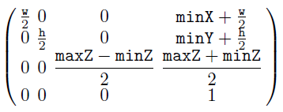
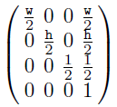
Viewport Transform
The viewport transform converts the objects in NDC into the screen space.
In most applications, minZ and maxZ are set to 0.0 and 1.0, respectively, and both of minX and minY are 0.
7-<number>

Slide 12
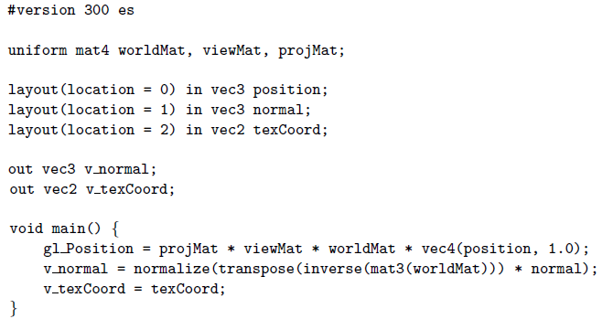
Vertex Shader (revisited)
Our first vertex shader (from Chapter 6)
Every vertex is associated with the attributes, v_normal and v_texCoord .
7-<number>

Slide 13
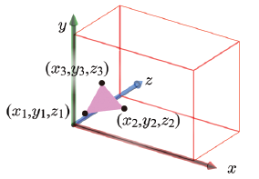
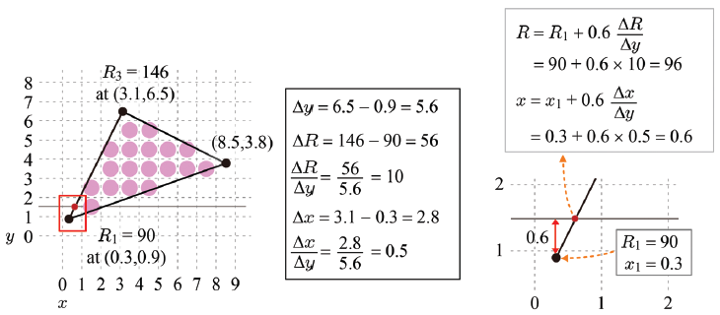
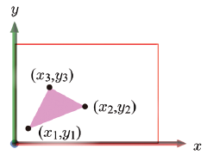
Scan Conversion
Scan conversion breaks up each triangle into a set of fragments. It identifies the pixels covered by the triangle and interpolates the vertex attributes (such as normals and texture coordinates) for each pixel location.
The per-vertex attributes usually do not include RGB color. Just for presentation, however, let’s assume color attributes and use R color for scan conversion.
A horizontal line of pixels is named a scan line.
7-<number>

Slide 14
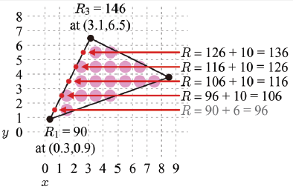
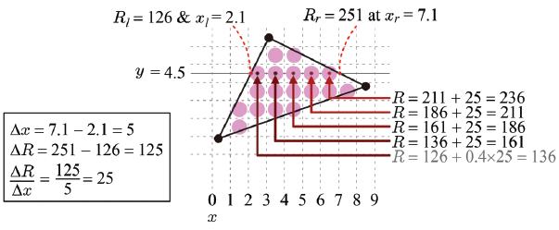
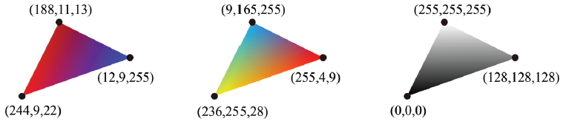
Scan Conversion (cont’d)
Bilinear interpolation – along the edges first, and then along the scan lines
Color interpolation examples
7-<number>

Slide 15
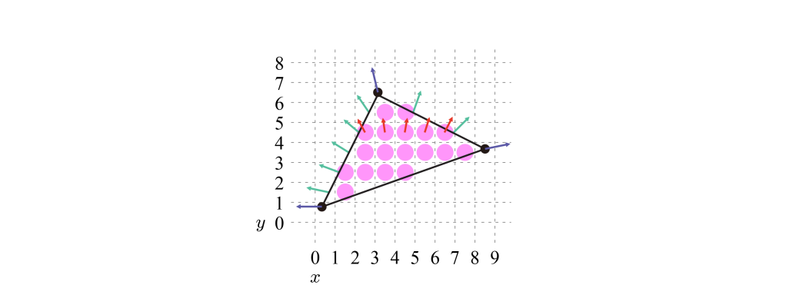
Normal Interpolation
Given (n_{x}, n_{y}, n_{z}) per vertex, each of n_{x}, n_{y}, and n_{z} is independently interpolated.
Then we have the following interpolated normals.
The per-fragment attributes produced by the rasterizer usually include a normal vector and texture coordinates.
7-<number>

